Slide 1
Employee Attrition Analysis Project
Leveraging Data Science to Understand and Project HR Trends
Name:- Prathamesh Pangare
Saurav Tejam
Mukesh Kale
Date:- 04-01-2024

Slide 2
Agenda
Introduction
Understanding HR Attrition
Project Overview
Data Handling
Exploratory Data Analysis (EDA)
Model Building
Insights and Patterns
Challenges and Solution
Conclusion

Slide 3
Introduction
Welcome to our presentation on a groundbreaking approach to understanding and managing employee attrition.
In today's fast-paced corporate environment, retaining top talent is more crucial than ever. Our project leverages advanced data analytics and machine learning techniques to delve deep into HR data, uncovering key patterns and factors driving attrition.

Slide 4
Understanding HR Attrition
Definition :- Attrition in HR refers to the natural process of workforce reduction due to employees leaving the company. This can be voluntary, such as through resignations or retirements, or involuntary, like layoffs or terminations.
Types of Attrition :-
Voluntary Attrition: Occurs when employees choose to leave the organization, often for reasons like career advancement, personal reasons, or better opportunities elsewhere.
Involuntary Attrition: Involves employees leaving due to organizational decisions, such as layoffs, restructuring, or termination due to performance issues.

Slide 5
The Role of Data Analysis
Understanding Attrition Leveraging data analytics and machine learning techniques to analyze HR data can provide valuable insights into attrition trends and patterns . This analysis helps in identifying risk factors and predictive indicators, allowing organizations to proactively manage and reduce employee turnover.

Slide 6
Project Overview
Objective: To analyze and predict employee attrition using data-driven approaches, enabling proactive HR strategies.
Scope of the Project Data Utilization: Leveraging a comprehensive HR dataset covering various aspects like demographics, job roles, satisfaction levels, income details, and more.
Analysis Techniques: Employing Exploratory Data Analysis (EDA) to uncover underlying patterns and using Machine Learning models for prediction.

Slide 7
Methodology
Data Collection: Gathering relevant HR data
Data Preprocessing: Cleaning and transforming data for analysis, including handling missing values, encoding categorical variables, and normalizing data .
Exploratory Data Analysis (EDA): Visualizing and examining data to understand trends, anomalies, and correlations .
Model Building: Developing predictive models using algorithms like Logistic Regression, Decision Trees, Random Forest, and Gradient Boosting.
Insight Generation: Extracting meaningful insights about factors influencing attrition and predicting future trends.
Goals and Expectations Predictive Insights: Identifying key factors that contribute to employee attrition, facilitating targeted intervention strategies.
Actionable Recommendations: Providing data-backed recommendations to HR for policy and strategic adjustments.
Enhancing HR Practices: Using the findings to improve employee retention, job satisfaction, and overall workplace environment.

Slide 8
Data Handling
Data Collection : we taken HR data from Kaggle website
Feature Engineering : we use one hot encoding and label encoding for converting categorical data .
Data Transformation : Handling missing value , scaling feature and dealing with outliers.
Data Splitting Training and Test : After Feature Engineering and Data Transformation , split data in 2 part in ratio of 70 train and 30 test .
Ensuring Data Quality Checks : checks data quality, outlier detection or validation of data .

Slide 9
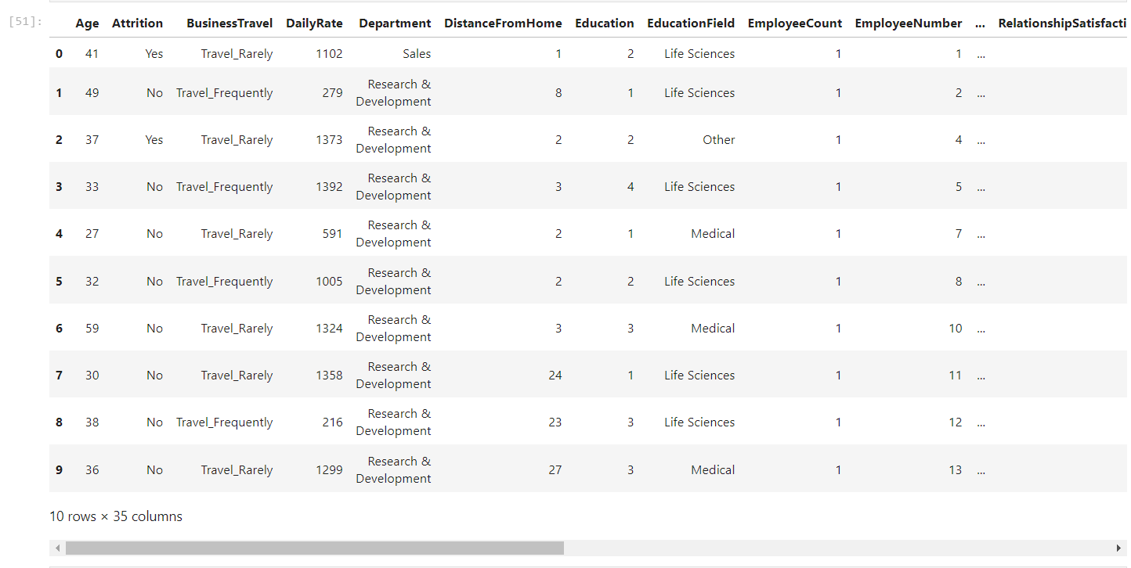
Exploratory Data Analysis (EDA) Objective : To explore and understand the data, uncovering key patterns, relationships, and anomalies.

Slide 10
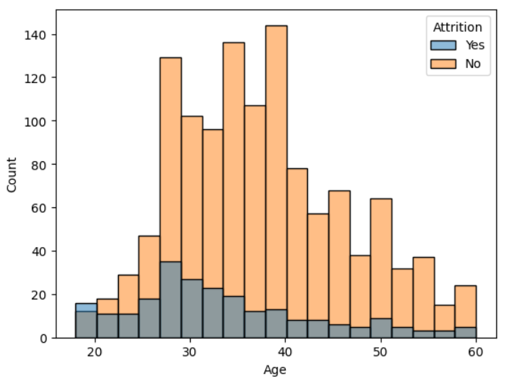
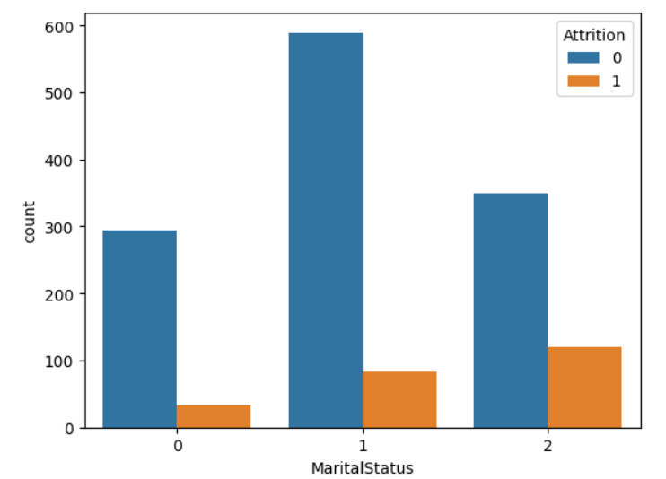
Demographic Analysis
Attrition by Age
Attrition by Marital Status
Divorced Married Single

Slide 11
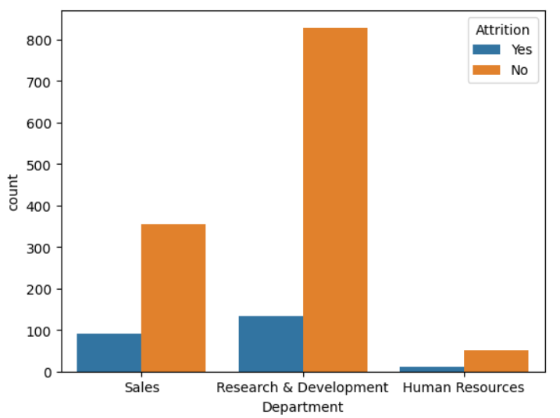
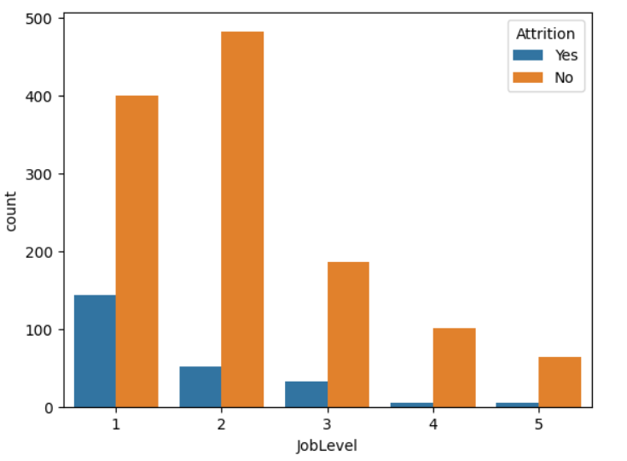
Job Related Analysis
Attrition by Department
Attrition by Job level

Slide 12
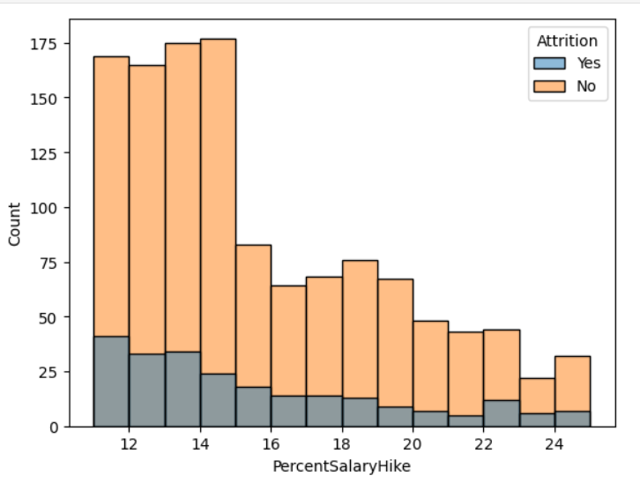
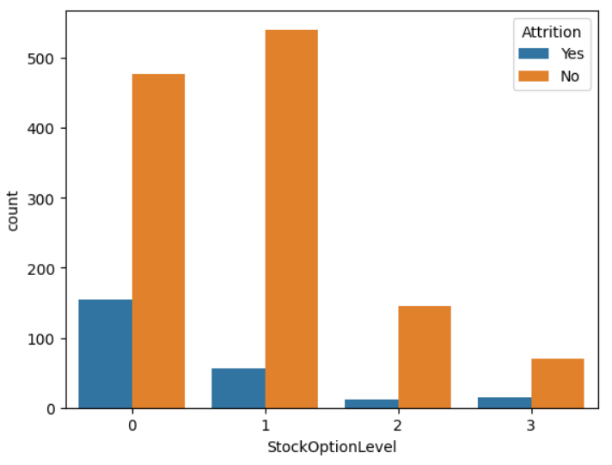
Compensation & Benefit Analysis
Attrition by Percent Salary Hike
Attrition by Stock Option Level

Slide 13
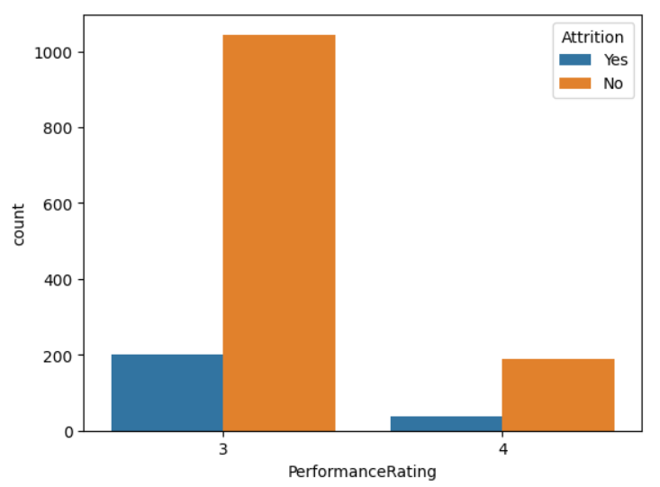
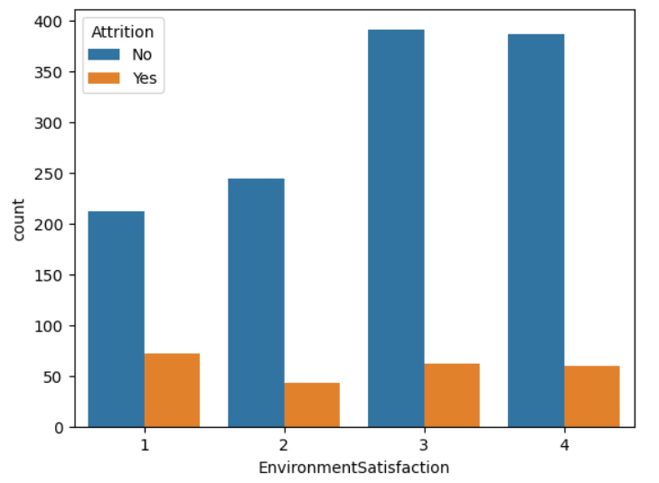
Work Environment & Performance
Attrition by Performance Rating
Attrition by Environment Satisfaction

Slide 14
Model Building
Purpose: To classify employees into two groups - those likely to leave (attrition) and those likely to stay .
Decision Tree Classifier
Choice of Model: A Decision Tree Classifier is chosen for its
Interpretability and ability to handle non-linear relationships .
Features Used: Key variables (e.g., job satisfaction, years at the company, salary level) used to predict attrition.

Slide 15
Model Training
Balance Data : Convert unbalance data in balance data for training .
Data Splitting: Dataset divided into training and testing sets .
Model Performance
Accuracy: Measurement of how well the model predicts employee attrition.
Implementation
Predictive Analysis: Use of the model to forecast potential attrition risk among current employees .
Risk Mitigation Strategies: Developing targeted strategies to address high-risk areas identified by the model.

Slide 16
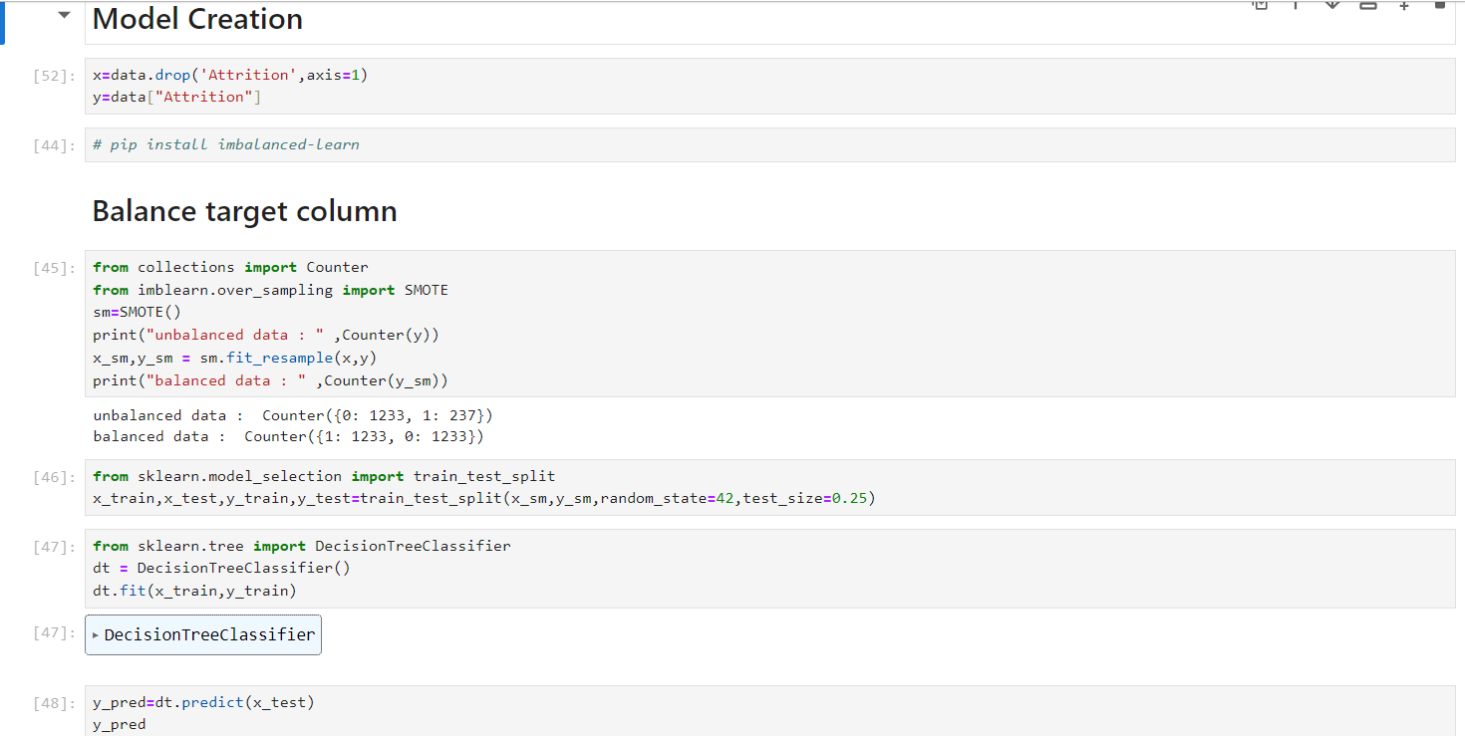
Model Building Code

Slide 17
Insights and Patterns
Major Patterns Identified Demographic Trends: Higher attrition rates in age of 18 to 25 who have single .
Compensation Factors : More Attrition rates find in Employee with low salary hike and low stock option level.
Work Environment :Employee have low work life balance and low job level and not satisfy in job environment have higher attrition count.
Predictive Factors of Attrition Top Predictors: Age , Job Satisfaction , percent hike Salary , job level , distance from home are the most influential variables in predicting attrition model

Slide 18
Policy Recommendations:
Regular Employee Feedback : Implement routine surveys and feedback mechanisms to understand employee needs and concerns .
Recognition and Reward Programs : Acknowledge and reward outstanding performance and contributions.
Professional Development Programs : Offer training, workshops, and courses for skill enhancement and career growth .
Clear Career Pathways : Provide transparent and achievable career progression opportunities .
Flexible Work Arrangements : Allow flexible hours, remote work options, or compressed workweeks .
Wellness and Mental Health Support : Prioritize employee wellness with initiatives like wellness programs or mental health days.

Slide 19
Challenges & Solutions
Data Quality and Completeness:
Inconsistent or incomplete data can lead to inaccurate predictions.
Solution: Implement robust data cleaning and preprocessing methods.
Model Complexity vs. Interpretability:
Striking a balance between a model that is both accurate and easy to interpret.
Solution: Decision Tree Classifier provides a good balance, being interpretable and reasonably accurate.

Slide 20
Changing Employee Dynamics:
Employee behavior and factors influencing attrition may change over time.
Solution: Regular model updates and retraining with new data.
Solutions to Enhance Model Efficacy
Continuous Data Monitoring :Regularly update the dataset to capture the latest trends and patterns.
Incorporating Employee Feedback : Utilize surveys or feedback tools to gather more qualitative data that can enhance the model.
Stakeholder Engagement : Work closely with HR professionals to understand domain-specific nuances and incorporate their insights into the model.

Slide 21
Conclusion
Summarizing key finding
Effective Prediction: The Decision Tree Classifier successfully identifies key factors contributing to employee attrition.
Insights into Attrition Drivers: Analysis highlights critical areas such as job satisfaction, work-life balance, and compensation as major influencers.
Data-Driven HR Strategies: The model provides actionable insights, enabling targeted strategies to reduce attrition rates.

Slide 22
Impact on the Organization
Enhanced HR Decision-Making: Empowers HR with predictive tools to proactively address attrition risks.
Improved Employee Retention: Potential to significantly reduce turnover rates, enhancing organizational stability.
Cost Savings: Lower attrition rates lead to reduced costs related to hiring and training new employees .

Slide 23
Future Directions
Model Refinement and Updates: Continuous improvement of the model with new data and feedback .
Broader Application Scope: Extend analysis to other aspects of HR like talent acquisition, employee engagement, etc .
Integration with HR Systems : Streamline the model's integration into existing HR workflows for real-time analysis.

